Slide 1
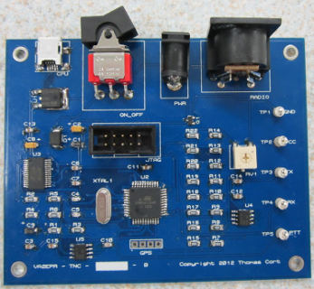
Terminal Node Controller Final Project
Thomas Cort

Slide 2
Motivation
Learning about digital communications.
Building a device that I will use.
Sharing my design and software with others.
Improving on existing technology.
Passing the course and graduating.

Slide 3
Outline
Introduction
Background Information
High Level Block Diagram
Schematic
Layout
Milestones
Statement of Feasibility
Questions

Slide 4
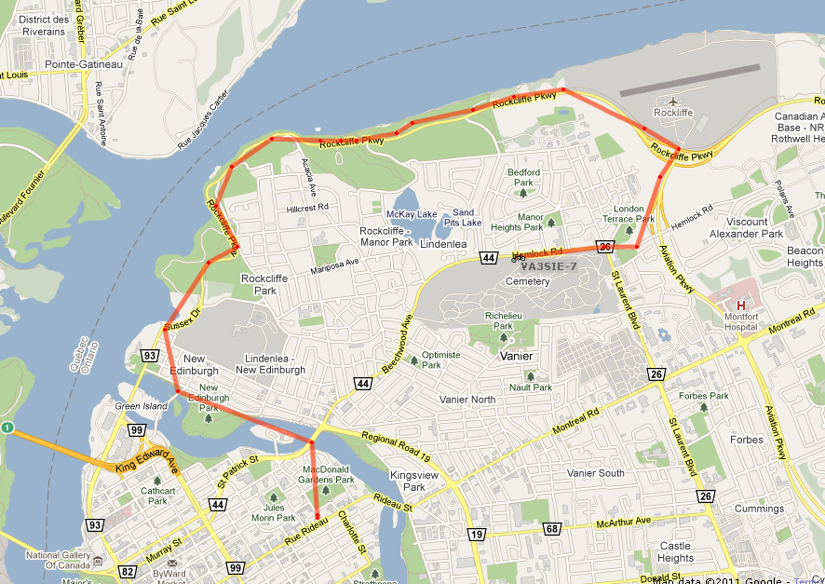
Introduction
Position Tracking System

Slide 5
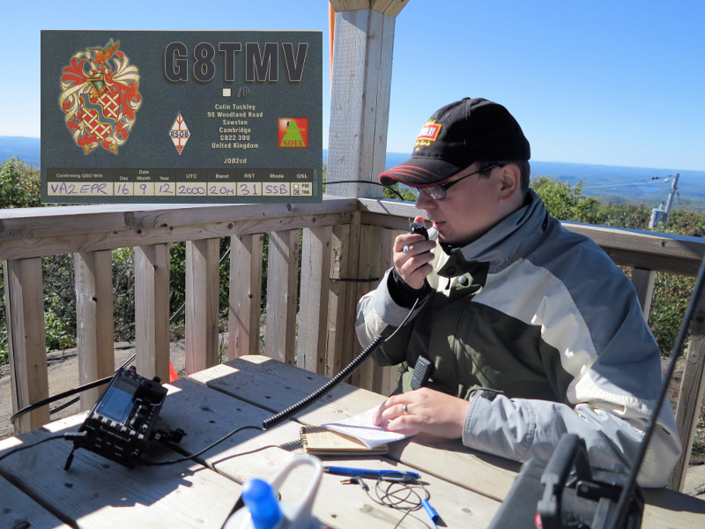
Background Information
Amateur Radio

Slide 6
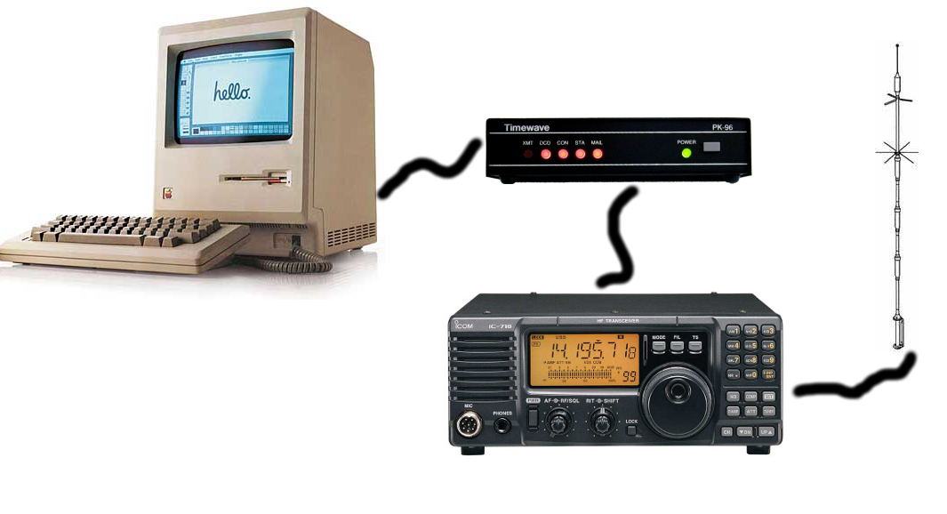
Background Information
Packet Radio Terminal Node Controllers

Slide 7
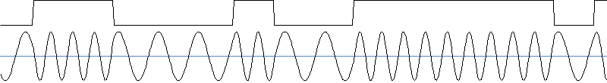
Background Information
Packet Radio Networks for Position Reporting
Network – APRS
Data link – AX.25
Physical – Bell 202 (1200 Baud AFSK NRZI)

Slide 8
Goals
Modern
Reliable
Low-cost
Easy to use
Open design
Small form factor
Portable version

Slide 9
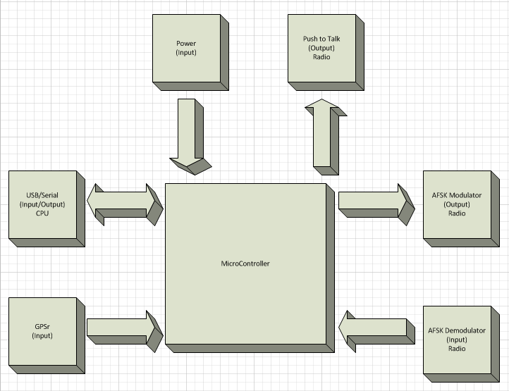
High Level Block Diagram

Slide 10
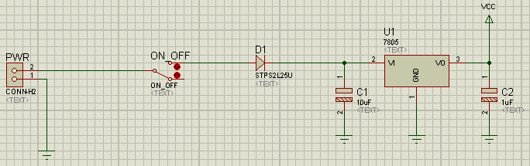
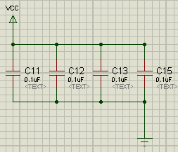
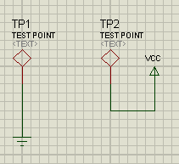
Schematic

Slide 11
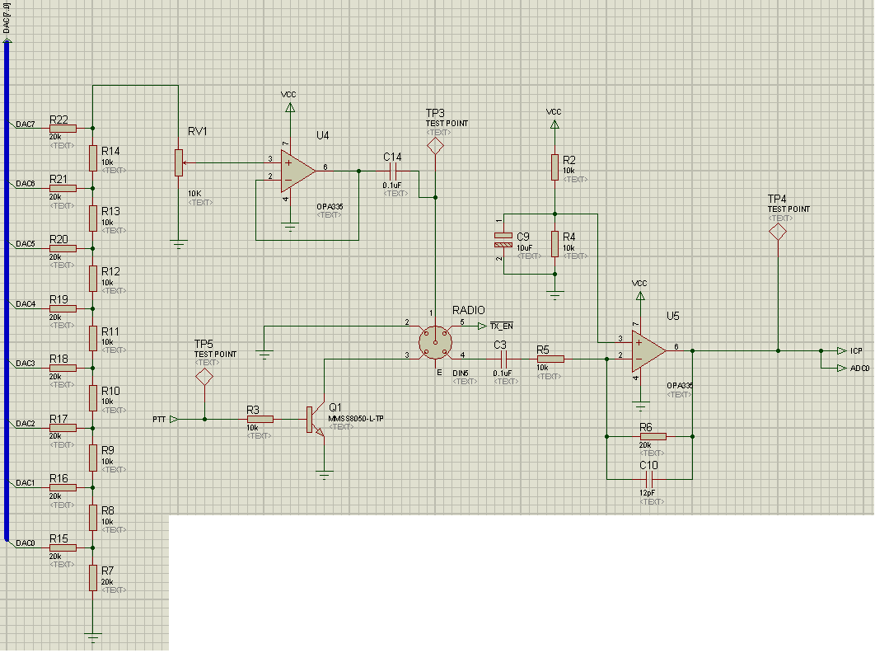
Schematic

Slide 12
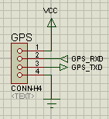
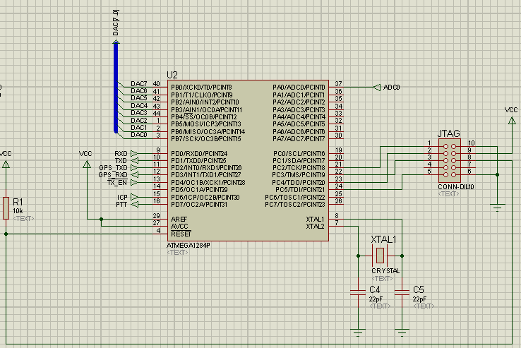
Schematic

Slide 13
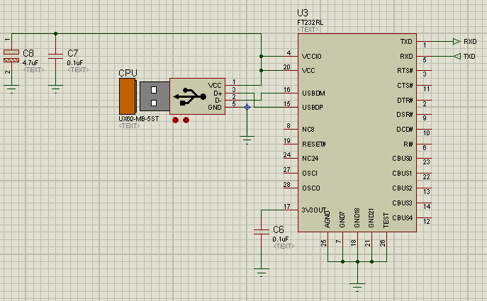
Schematic

Slide 14
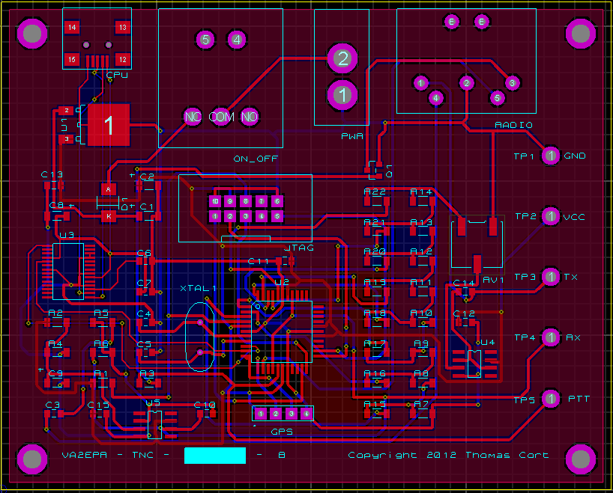
Layout

Slide 15
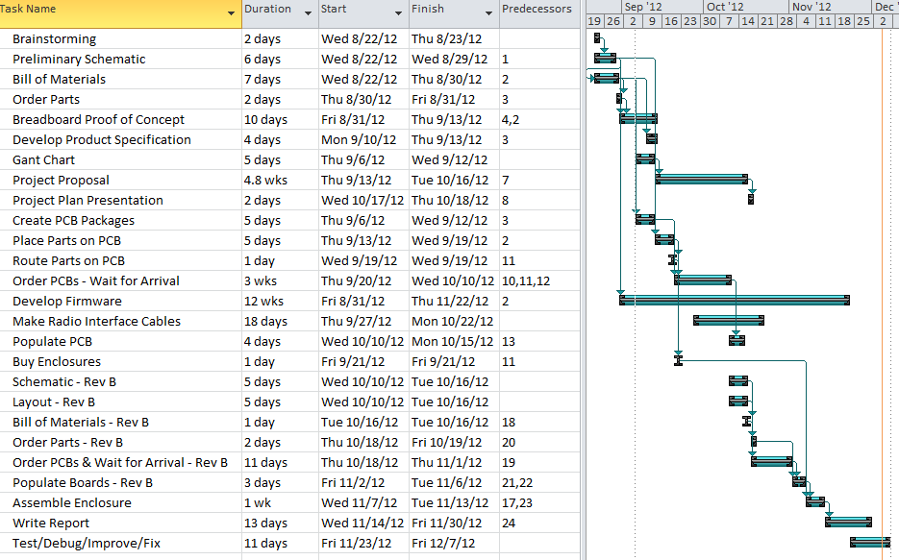
Milestones

Slide 16

Statement of Feasibility

Slide 17

Questions?

